Slide 1
Multiple Genome Alignment with Mauve
Microbial Genome Sequence Analysis
06 June 2024
Phuc Loi Luu, PhD
Luu.p.loi@googlemail.com

Slide 2
Content
Brief introduction of Microbial Genome Analysis
Multiple Genome Alignment with Mauve
Homework

Slide 3
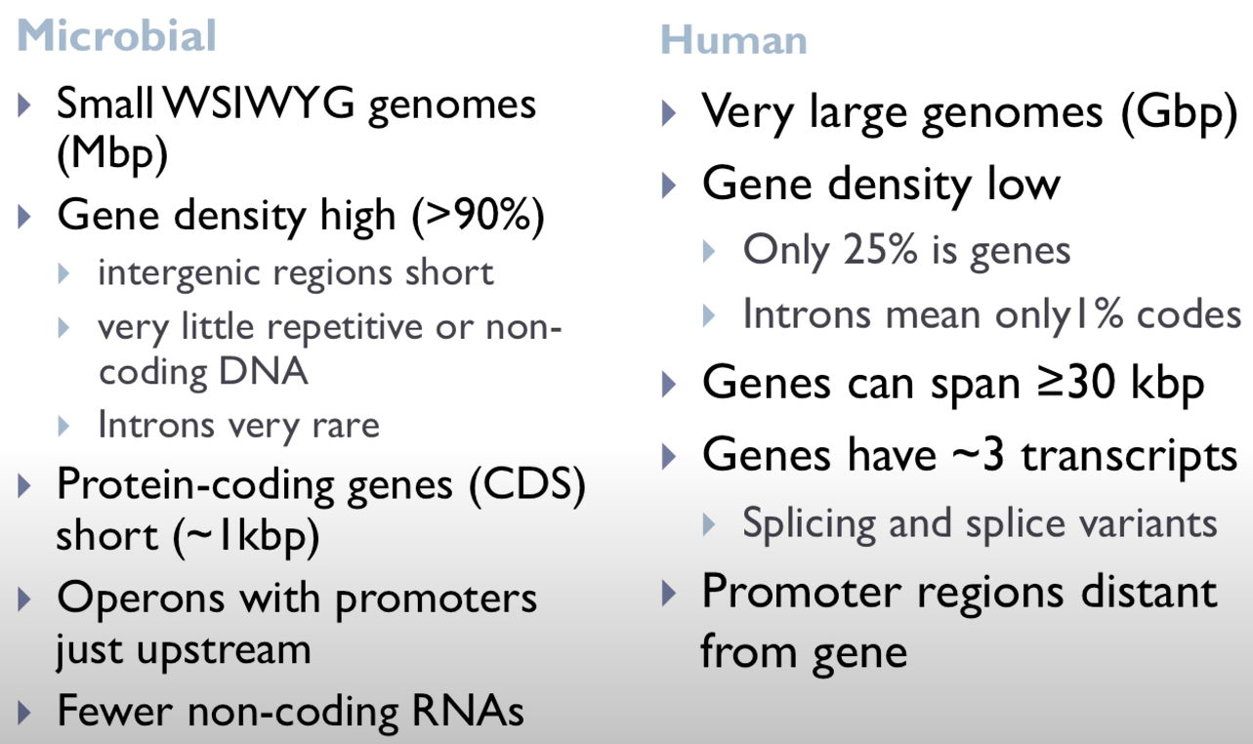
General features of genomes

Slide 4
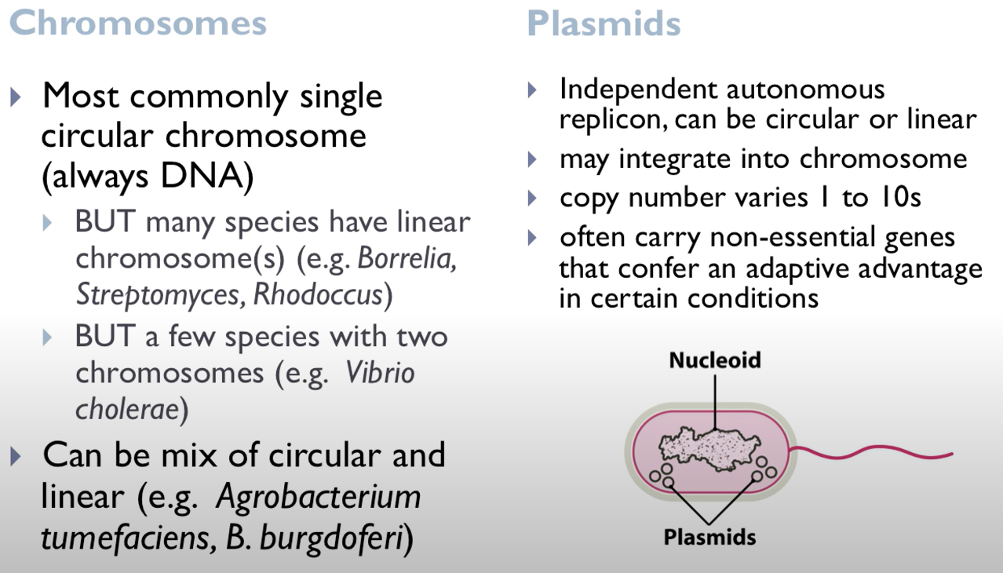
Bacterial genome organisation

Slide 5
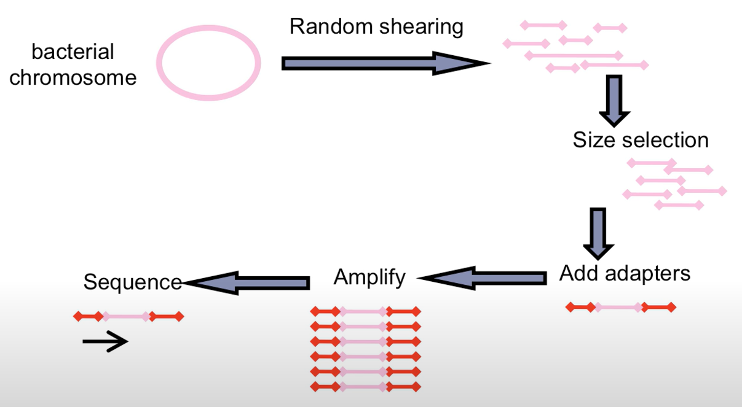
Whole genome sequencing – Shotgun method

Slide 6
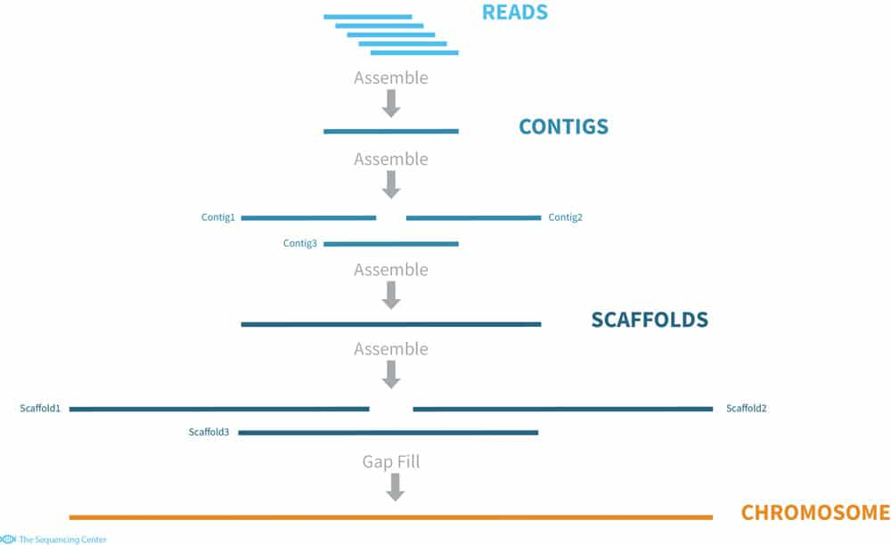
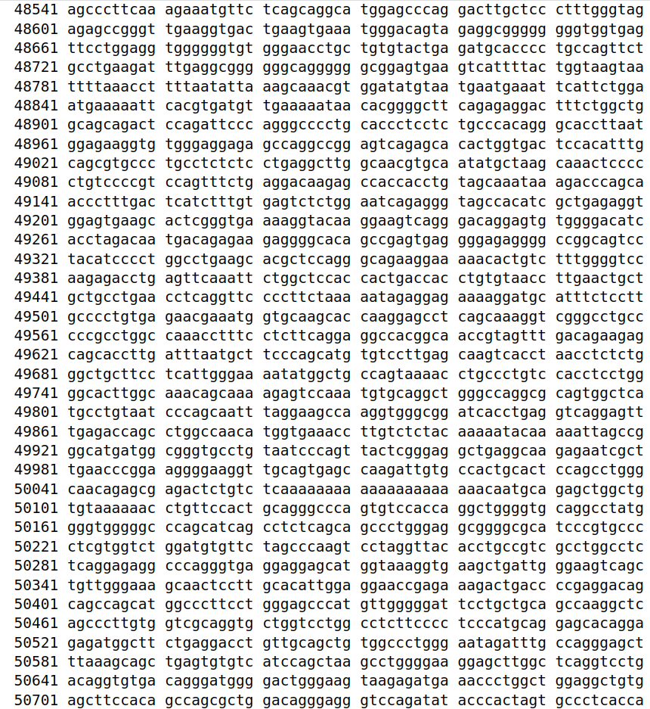
De novo assembly

Slide 7
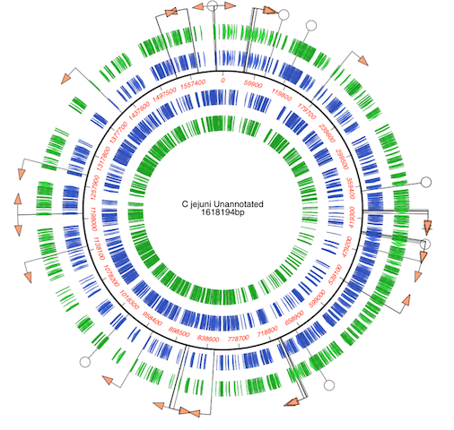
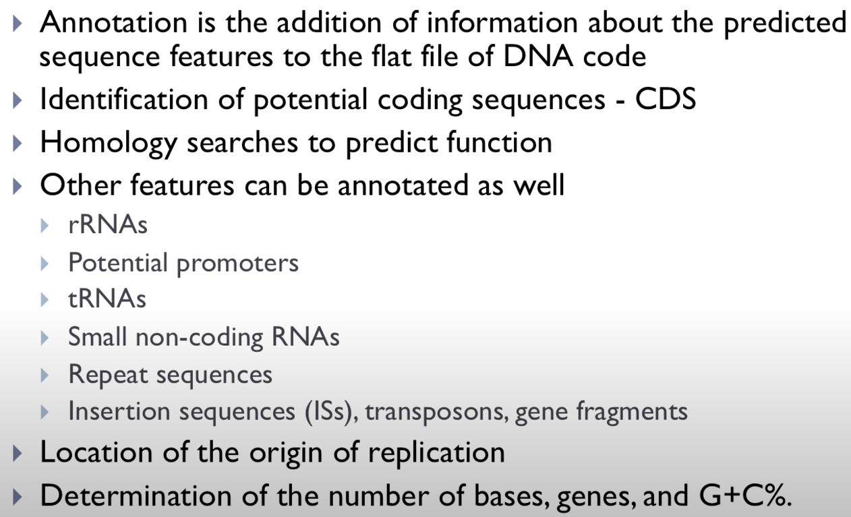
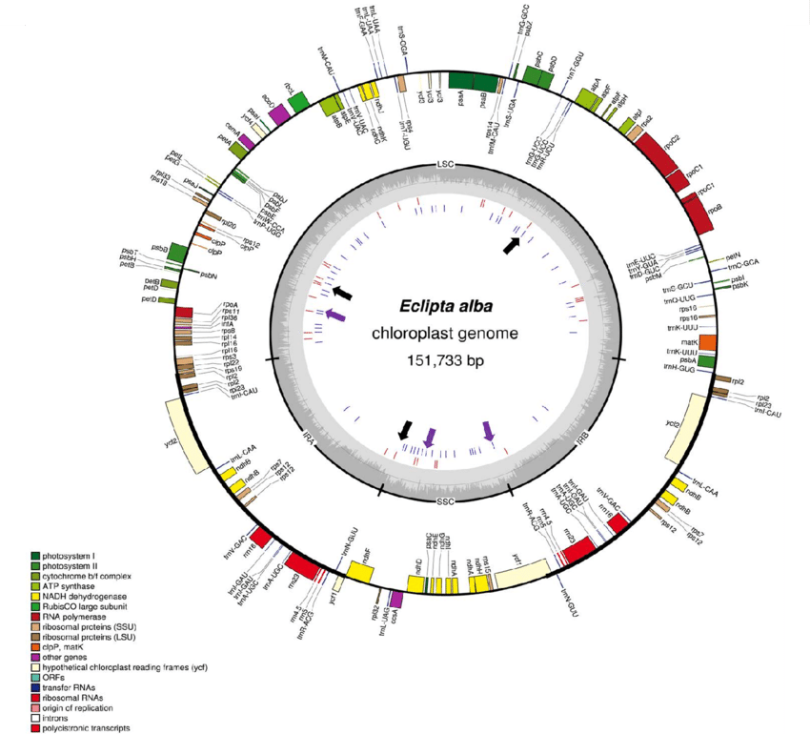
Genome annotation

Slide 8
Tools for gene annotation in prokaryotes
National Center for Biotechnology Information (NCBI) Prokaryotic Genome Annotation Pipeline (PGAP)
Prokka (prokaryotic annotation)
RAST (Rapid Annotations using Subsystem Technology)
DRAM (Distilled and Refined Annotation of Metabolism)
Augustus (for eukaryotes and prokaryotes)
Glimmer3 (only for prokaryotes)
Prokaryotic Genome Annotation Guide Annotation Genome Workbench and table2asn (the replacement of tbl2asn)
These tools start from genomes and predict genes and proteins, tRNAs, rRNAs, and perform functional annotation of the predicted proteins

Slide 9
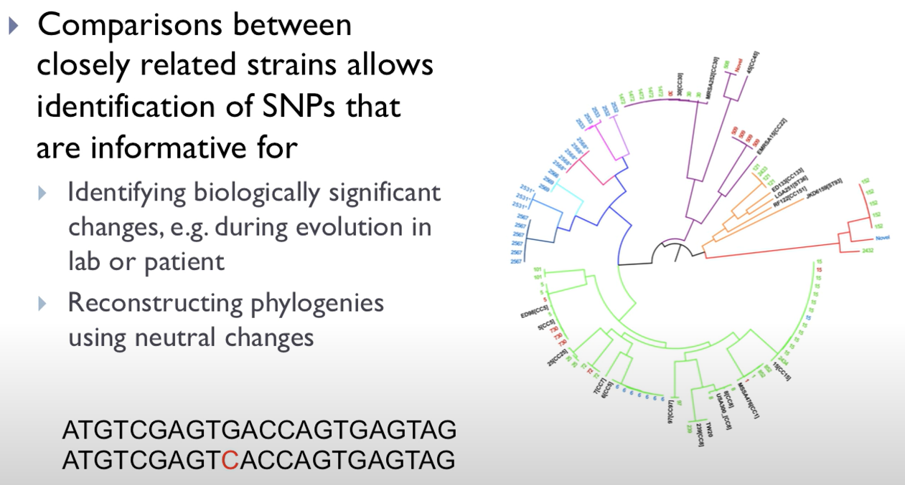
SNP calling

Slide 10
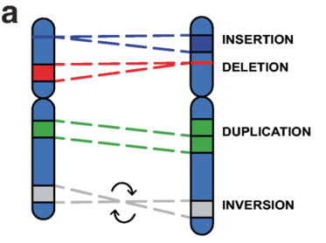
Large-scale mutation
Inversion
Horizontal gene transfer
Homologous recombination
Gene Duplication/Loss
→ Problem: Genetic elements may not have conserved order and orientation in the other genomes

Slide 11
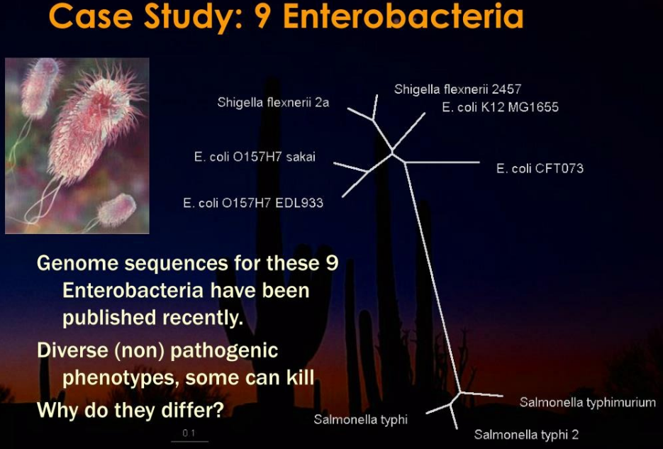

Slide 12
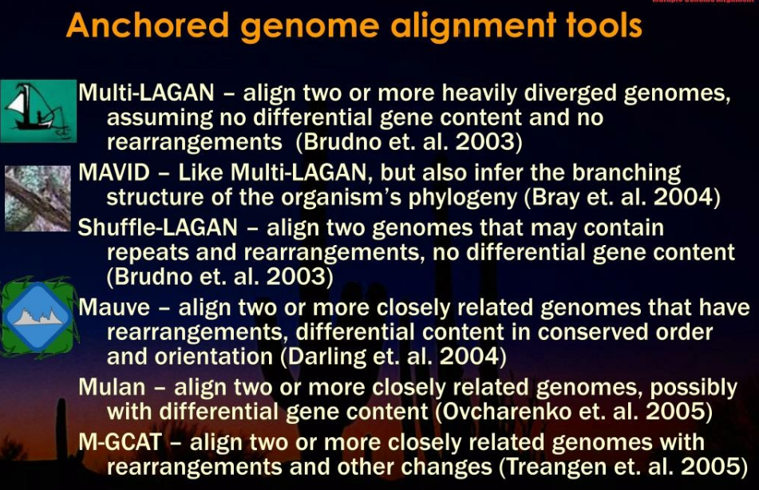

Slide 13


Slide 14
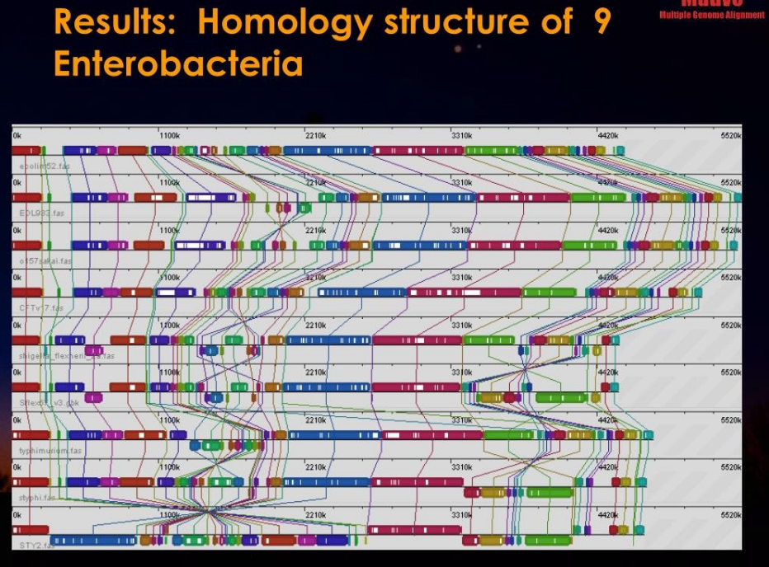

Slide 15
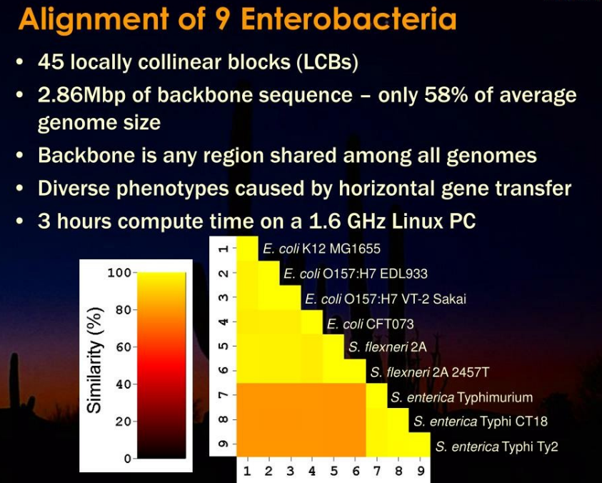

Slide 16

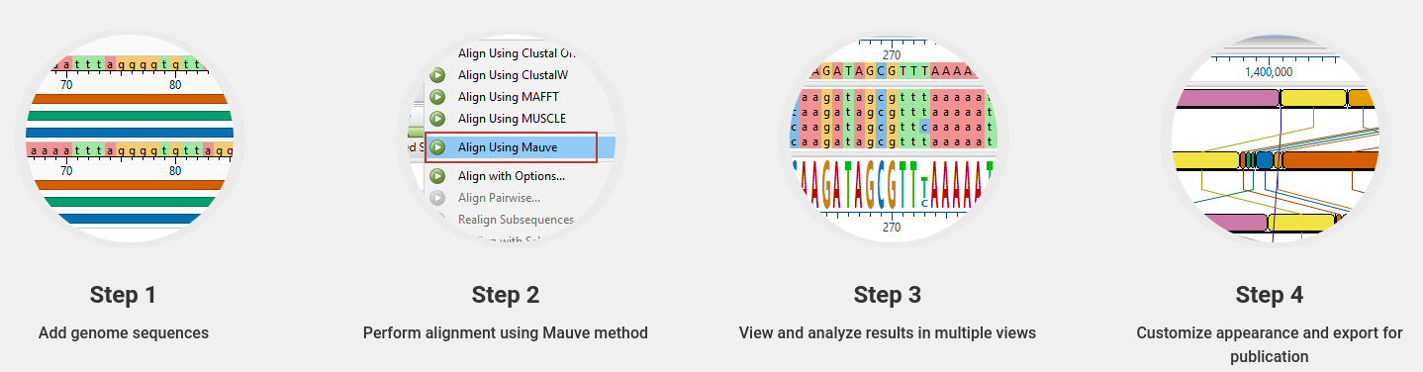
Multiple Genome Alignment with Mauve
https://darlinglab.org/mauve/mauve.html

Slide 17
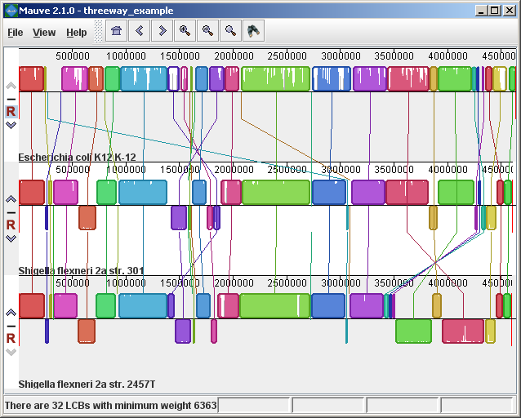
Localized Co-linear Blocks (LCB)
Genomes diverge from an ancestral species into two or more modern species, chromosomes undergo many sorts of rearrangements, including insertions, deletions, inversions and translocations.
Much of the same sequences remain even after long periods of evolutionary history, but in different arrangements from one species to the next.
LCBs are regions of chromosomes that appear to be conserved across all species being examined.
If an entire chromosome is unchanged, then the entire chromosome would be a single LCB in all species in the alignment.
Many chromosomes will be a mosiac of several LCBs.
In other cases, an LCB on one chromosome will be found on a different chromosome, indicating a translocation.
The purpose of Mauve, then is to calculate the LCBs shared between two or more genomes, and to display them visually.
https://home.cc.umanitoba.ca/~psgendb/tutorials/bioLegato/getgenome/Mauve.html

Slide 18
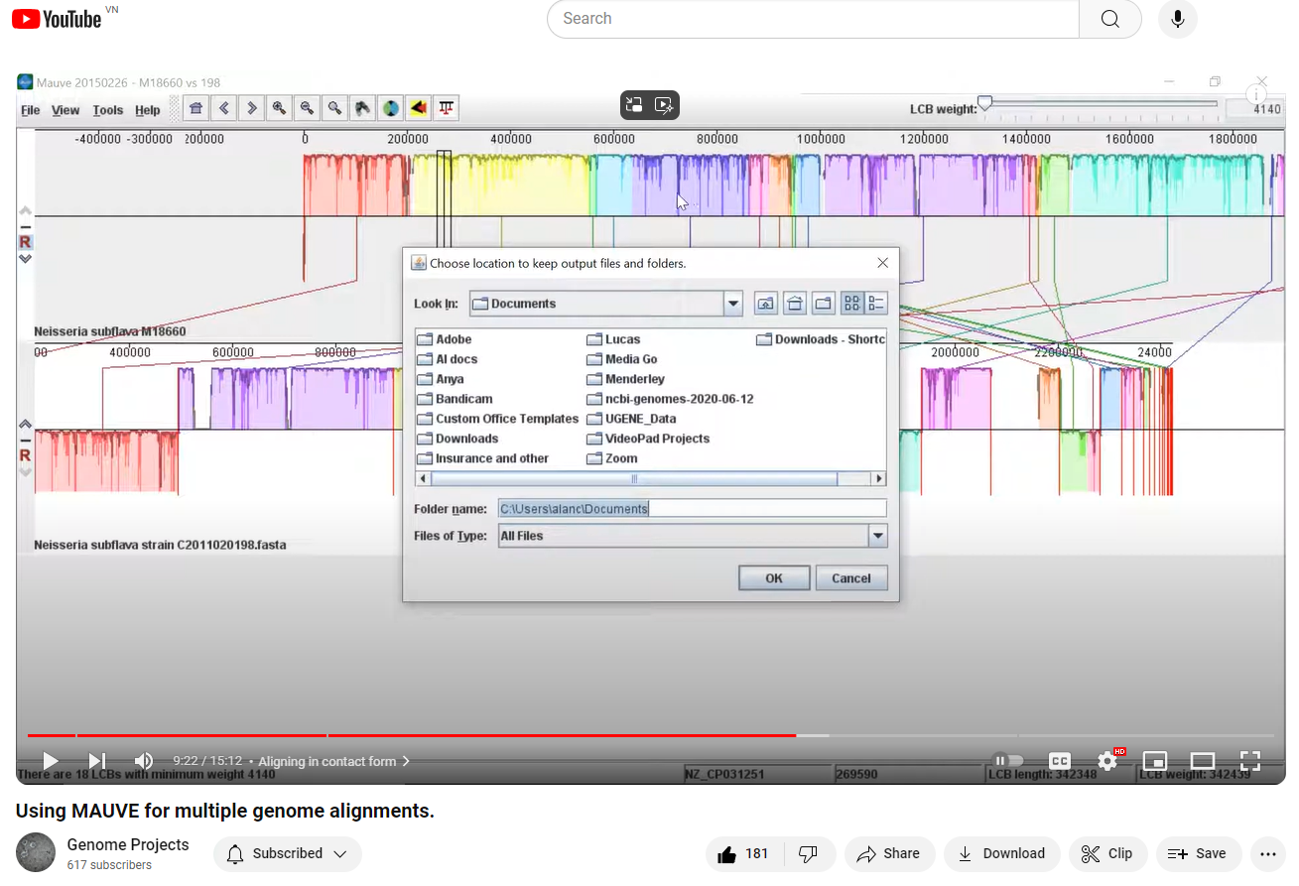
Tutorial of using MAUVE for multiple genome alignments
https://www.youtube.com/watch?v=KGTSn80XzBo

Slide 19
Homework
Search for the sequences of E. coli CFT073, E.coli K12 MG1655 and E. coli O157H7
How long these genomes?
Using MAUVE for multiple genome alignments of these 3 genomes

